Slide 1
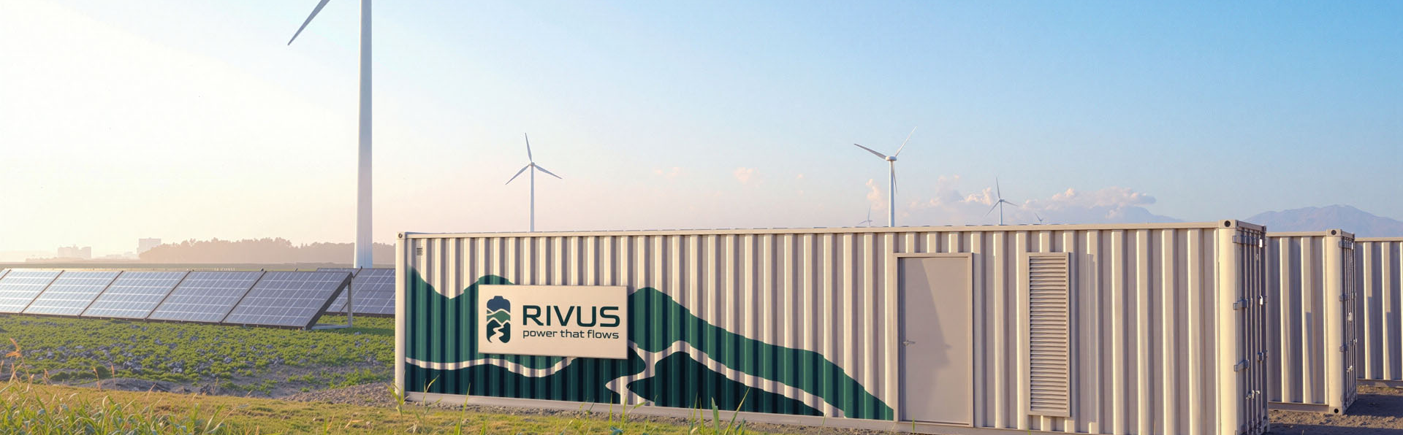

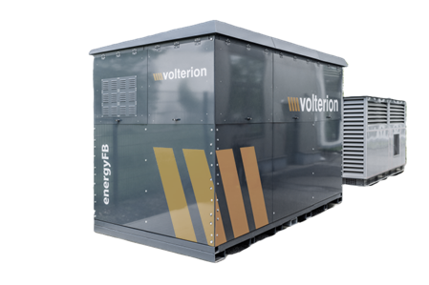
Simulation Findings Sheet – {{cor_na}}
We simulated how a 150 kWh, 25 kW battery + PV affects your electricity cost and grid fees based on your {{data_year}} data. Key outcomes:
{{pb_b_1}} – {{pb_b_4}} years
{{ss_incr}} – {{ss_incr2}}x
Payback time of the battery
With Peak Shaving, Arbitrage, and Ancillary Market revenues
Increase in self-sufficiency
% of on-site electricity demand met by PV with “self-sufficiency” objective
Revenue Share by type*
Peak Shaving {{PPS}}%
Arbitrage {{PARB}}%
^{13-ft Organic flow battery}
Fire-proof, sustainable & low lifecycle cost
Ancillary Market Revenue {{PAMR}}%
Specifications and parameters
Battery type: Organic Flow Battery, 13-ft
Power rating: {{pow_1}} kW
Capacity rating: {{cap_1}} kWh
Investment cost: €{{b_in_1}} (€400/kWh | Includes: battery, PCS, BoP. Excludes: Installation cost)
Pilot lifetime guarantee: >5000 cycles or 7 years with >70% remaining capacity
Round-trip efficiency: {{efficiency}}% AC-AC
Operating SOC window: 100%
Electricity demand data: {{demand_data_range}}
Electricity cost & FCR data: {{price_data_range}}
Additional Information
{{additional_information}}
check
info@rivus-batteries.com 0046 763 01 29 16 www.rivus-batteries.com

Slide 2


Findings – {{cor_na}} Average annual demand: {{total_demand}} MWh Total PV generation in period: {{solar_mwh}} MWh
 | 2024 |  |  | 2025
Simulation / ​​Use-case | Baseline | Battery I ({{cap_1}} kWh, {{pow_1}} kW) | Battery II ({{cap_2}} kWh, {{pow_2}} kW) | Baseline | Battery I ({{cap_3}} kWh, {{pow_3}} kW) | Battery II ({{cap_4}} kWh, {{pow_4}} kW)
 | PV installed | Peak Shaving, Arbitrage, Ancillary Market revenues | Self-sufficiency objective and Peak Shaving, Arbitrage, Ancillary Market revenues | PV installed | Peak Shaving, Arbitrage, Ancillary Market revenues | Self-sufficiency objective and Peak Shaving, Arbitrage, Ancillary Market revenues
Total investments PV or Battery (B) | PV: €{{pv_in}} B: €0 | PV: €{{pv_in}} B: €{{b_in_1}} | PV: €{{pv_in}} B: €{{b_in_2}} | PV: €{{pv_in}} B: €0 | PV: €{{pv_in}} B: €{{b_in_3}} | PV: €{{pv_in}} B: €{{b_in_4}}
Average electricity cost / year | €{{c_k_pv_1}}/kWh | €{{c_k_pvb_1}}/kWh | €{{c_k_pvb_2}}/kWh | €{{c_k_pv_3}}/kWh | €{{c_k_pvb_3}}/kWh | €{{c_k_pvb_4}}/kWh
Total annual electricity cost | €{{c_pv_1}} | €{{c_pv_bat_1}} | €{{c_pv_bat_2}} | €{{c_pv_3}} | €{{c_pv_bat_3}} | €{{c_pv_bat_4}}
Annual ancillary market revenue | - | €{{fcr_rev_1}} | €{{fcr_rev_2}} | - | €{{fcr_rev_3}} | €{{fcr_rev_4}}
Grid fees saved | - | €{{s_pcf_1}} | €{{s_pcf_2}} | - | €{{s_pcf_3}} | €{{s_pcf_4}}
Annual savings from the Battery (B) & PV | - PV: €{{s_pv_1}} | B: €{{s_b_1}} PV: €{{s_pv_1}} | B: €{{s_b_2}} PV: €{{s_pv_2}} | - PV: €{{s_pv_3}} | B: €{{s_b_3}} PV: €{{s_pv_3}} | B: €{{s_b_4}} PV: €{{s_pv_4}}
Payback time Battery | - | {{pb_b_1}} years | {{pb_b_2}} years | - | {{pb_b_3}} years | {{pb_b_4}} years
Self-sufficiency % of on-site electricity demand met by PV | {{ssr_pv_1}}% | {{ssr_t_1}}% | {{ssr_t_2}}% | {{ssr_pv_3}}% | {{ssr_t_3}}% | {{ssr_t_4}}%
Equivalent Full Cycles per year | - | {{cycles_1}} cycles | {{cycles_2}} cycles | - | {{cycles_3}} cycles | {{cycles_4}} cycles
Time inside SoC 20%-80% | - | {{t_20_80_1}}% | {{t_20_80_2}}% | - | {{t_20_80_3}}% | {{t_20_80_4}}%
Total MWh charged /discharged | - | {{charge_1}} MWh | {{charge_2}} MWh | - | {{charge_3}} MWh | {{charge_4}} MWh
info@rivus-batteries.com 0046 763 01 29 16 www.rivus-batteries.com

Slide 3
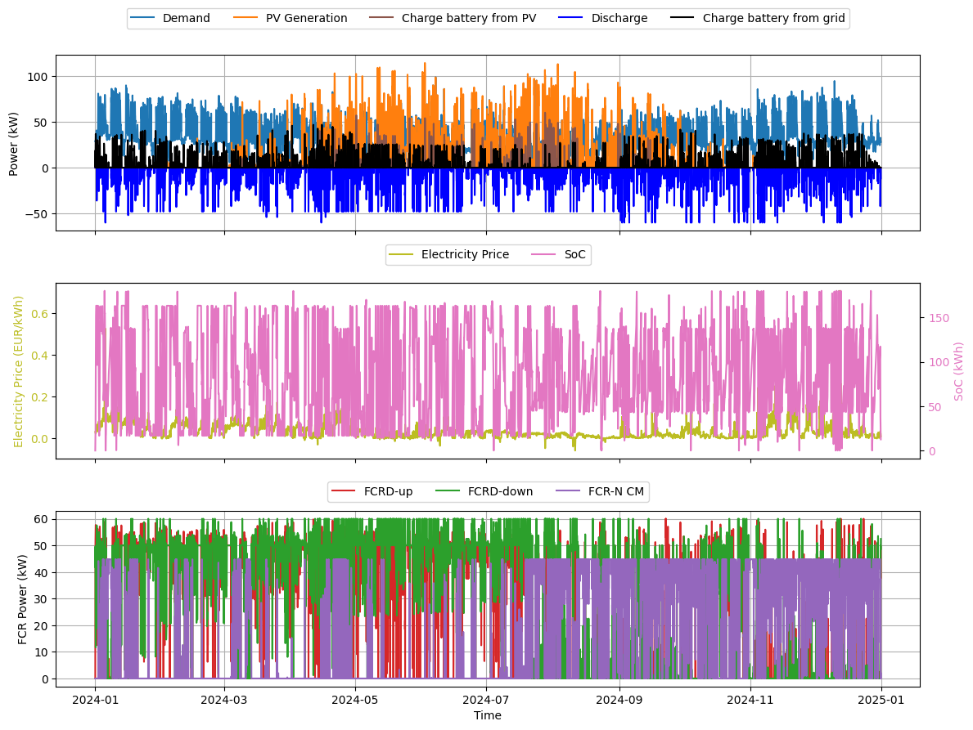
Simulation results in more detail
check
We invite those interested to explore the batteries’ behaviour. How? Click on this link here and download the file you’d like to see to a good location on your computer. From there, open the HTML document (for example in your web browser) and you’ll be able to zoom in and check out what happens during every hour of the day!
The HTML will look something like the figure below:
Amount of energy charged (black) and discharged (blue)
Electricity price (yellow) and the battery’s state of charge (pink)
Bid quantity of ancillary services for the various capacity markets
Key assumptions and parameters
Electricity cost Day-ahead prices SE3, repeated over lifetime
Ancillary market revenue Participation in FCR-N,FCR-D up/down, mimer.svk.se
Grid fees costs saved Effect of peak shaving on demand charges (4 €/kW)
Operating SOC window: 100%
IRR/NPV N/A – not used in the simulation
If you’d like to move forward, we’d be happy to outline the next steps! Just let us know if you have any questions. We are ready to deliver the 25 kW, 150-kWh battery in 2027.
info@rivus-batteries.com 0046 763 01 29 16 www.rivus-batteries.com

